Slide 1
YouthTEACH2Learn:
Test Drive a Career in STEM Teaching
Vinh Luong
Program Manager
Project Tomorrow

Slide 2
Today’s discussion topics
About Project Tomorrow
Developing the next generation of STEM teachers
Challenges
Opportunities
Research
Introduction to the YouthTEACH2Learn program and curriculum
Partnership Opportunities
Your thoughts, comments & questions

Slide 3
Project Tomorrow, a national education nonprofit organization
Mission: to ensure that today’s students are prepared to become tomorrow’s leaders, innovators and engaged citizens of the world
Activated by: research based, effective use of STEM resources in both formal and informal learning environments

Slide 4
About Project Tomorrow / Context
NetDay origins
Re-invented organization
New focus and market approach
Tomorrow’s Teachers Initiative
STEM Programs for Students
Speak Up National Research Project and Services
Digital Learning Research and Evaluation Studies

Slide 5
About Project Tomorrow / Context
Speak Up National Research Project and Services
Deep focus on the value of education stakeholder views – especially students
Tomorrow’s Teachers Initiative
STEM Programs for Students
Digital Learning Research and Evaluation Studies

Slide 6
About Project Tomorrow / Context
Tomorrow’s Teachers Initiative
YouthTEACH2Learn Program and Curriculum
California Future Educators’ Association
Informed by these projects and programs
STEM Programs for Students
Speak Up National Research Project and Services

Slide 7
Challenges
Inadequate supply of math and science teachers in the field today
Less than half of chemistry and physics teachers majored in those subjects
¼ of math teachers don’t have a math degree
Increasing demand for more math and science teachers
CA needs 33,000 new math and science teachers within 10 years
Diminished pipeline for new teachers
CSU has seen steady decrease in teacher candidates since 2009

Slide 8
Opportunities
Build new pipelines
Alternative certification programs
CAL Teach
100Kin10 Network
Moving the starting line to high school for teaching careers
Strength linkage between K-12 and higher education around career development
Project Tomorrow’s CFEA Conference
Move the starting line
YouthTEACH2Learn program and curriculum

Slide 9
Research
Project Tomorrow’s Speak Up National Research Project – 2011
Are you interested in a job or career in teaching or a related education field?
Response | CA HS Students N = 12,573 | All HS Students N = 93,000
No, I am not interested | 58% | 61%
Maybe or somewhat interested – but need more information about teaching careers | 35% | 32%
Yes, I am very interested in a job or career in teaching | 6% | 7%

Slide 10
Research
Project Tomorrow’s Speak Up National Research Project – 2011
What would help increase your interest in a career you have been thinking about?
63% of high school students say a part-time job or internship
57% say a program at school about future careers
32% say participate in an after school program
26% say take a CTE class at school

Slide 11
Research
Project Tomorrow’s Speak Up National Research Project – 2012
When did you decide that you wanted to be a teacher?
45% of pre-service teachers say it was before getting to college – 23% say it was in high school

Slide 12
Research
Project Tomorrow’s Speak Up National Research Project – 2012
When did you decide that you wanted to be a teacher?
45% of pre-service teachers say it was before getting to college – 23% say it was in high school
What is the driving influence on your decision to become a teacher?
71% of pre-service teachers say “to make a difference in the world”
65% say “desire to work with children”
62% say “a favorite teacher that I had in school”

Slide 13
Project Tomorrow Solutions
YouthTEACH2Learn Program and Curriculum
Future Educators’ Association
Speak Up Research Project

Slide 14
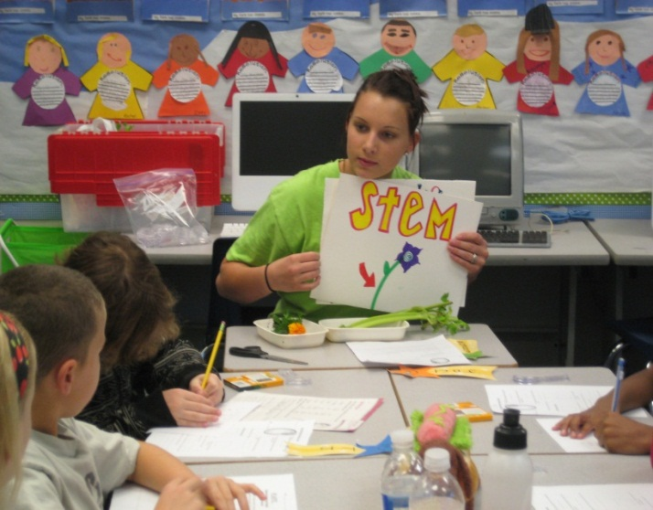
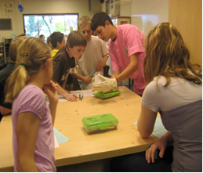
Introduction to YouthTEACH2Learn
National recognized program – teacher developed
Full year or after school curriculum
Twenty modules aligned with CTE standards, Common Core Math Standards and Next Generation Science Standards
Online tools and resources to support students and teachers
15 years of successful implementation in California
12,750 high school students – 40% pursued teaching careers

Slide 15
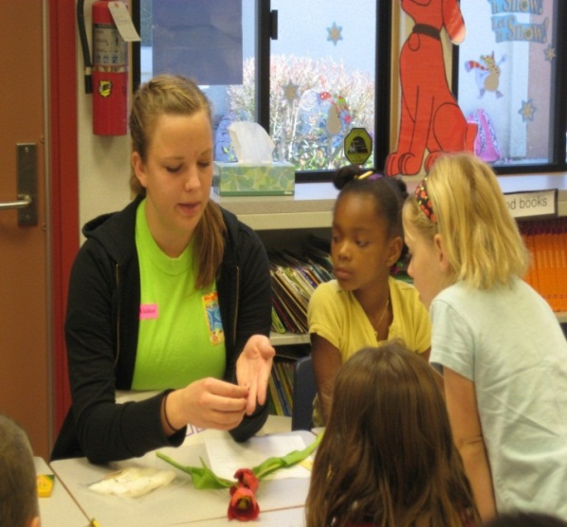
Introduction to YouthTEACH2Learn
High school students:
Enroll in YT2L class within the bell schedule – we provide curriculum and supplemental resources
Curriculum is modeled after college introduction to teaching course curriculum
Learn how to teach hands on science/math lessons
Teach lessons to elementary students 6-8x a year
Test-drive teaching as a career
Increase personal interest in science
and math careers
Develop 21st century skills

Slide 16
Introduction to YouthTEACH2Learn
Elementary students:
Increase exposure to hands on, inquiry based science and math
Increase sustainable interest in science and math
Increase proficiency on state standardized tests
Role modeling and mentoring by older students
Elementary teachers:
Acquire hands on lesson plans
Increase confidence in science and math instruction
Observe students in learning process
Mentor next generation of teachers

Slide 17
Program impact summarized
Impact | ES Students | HS Students | ES Teachers
Increased science knowledge | X | X | X
Increased science test scores | X
New enthusiasm for science | X | X | X
Take more/advanced science in middle and high school | X
Good role models | X
Greater interest in science and math careers | X | X
Acquire new strategies for teaching science and math |  |  | X
More confidence in doing hands-on science and math activities |  |  | X
Develop 21st-century skills |  | X
Greater respect for teachers |  | X
Test drive teaching as a career |  | X

Slide 18
Program impact summarized
66% of students report increased interest in teaching after participation in YT2L
Over 92% say program helped them develop and improve 21st century job skills (teamwork, leadership, public speaking, problem solving)
43% report that they will pursue a degree in education/teaching
90% of elementary teachers report the program increased their students’ interests in science and math

Slide 19
Participating school sites in CA
Trabuco Hills High School (Saddleback Unified)
Since: Fall 1997
Elementary Site(s): Cielo Vista, Melinda Heights, Glen Yermo, Robinson Ranch, Trabuco, Trabuco Mesa
50 HS Students teaching 1185 ES Students
San Juan Hills High School (Capistrano Unified)
Since: Fall 2010
Elementary Site(s): Ambuehl
28 HS Students teaching 90 ES Students
Tiger Woods Learning Center (Anaheim)
Beginning: Fall 2013
High School (s): Savanna HS, Loara HS, Kennedy HS, Western HS, Anaheim HS, Fullerton HS
Elementary Site(s): Gauer Elementary / Anaheim Achieves After School Program
15 HS Students teaching 50 ES Students
Jefferson High School (L.A. Unified)
Beginning: Fall 2013

Slide 20
Program components we provide
Comprehensive curriculum for high school or college class
Professional development for high school teacher advisor
Online portal for students and teachers includes resource directory and wiki-style directory of student-developed lessons
A stipend for science/math supplies to support the hands-on lessons developed by high school students
Project management and coordination and scheduling support for schools
Three levels of evaluation processes and impact reporting
Mentoring for high school students – from industry experts and university professors
Program affiliation with the Future Educators’ Association

Slide 21
Required support from the school
Teacher for HS class – 1 period per day
Release time for teachers to participate in program meetings and professional development events
Facility use for supplies and other program materials

Slide 22
Mission: To attract, equip, and provide experiences for students who are interested in teaching and to provide essential skills that will lead to highly trained and qualified teachers
Selected by national organization to start California affiliate
Over 11,000 members nationwide last year
1 of 11 Nationally Recognized CTSOs

Slide 23
School based chapters
Specifically valuable for students in ROP Child Development and Careers in Education classes
Student/Advisor Workshops and Conferences: Regional, State, and National
Chapter, State, and National officer positions
Scholarship opportunities
Competitions amongst chapters
Lesson Plan Repository
Subscription to Go Teach quarterly magazine

Slide 24
Bonus for California chapters:
Special access to YouthTEACH2Learn curriculum for chapters in California
Opportunity for your students to attend a regional conference

Slide 25
CA FEA Conference: @ Saddleback College 5/17/13
Breakout sessions included:
The 21st Century Classroom: Meaningful Ways to Use Technology
Early Childhood Education-Child Care Careers
Undergraduate Preparation for Future K-12 Teachers
Hands on STEM education
The College Experience-Student Panel
Positive Student Engagement Strategies and Teaching Techniques
Teachers Tell All: New and Veteran Teachers Panel
Campus Tour

Slide 26
CA FEA Conference: @ Saddleback College 5/17/13
“I am thankful to have this opportunity to explore the teaching profession and the information I learned is very helpful.”
“I learned a lot of interesting and useful information about going to college, career paths and steps, and information on becoming a teacher.”
“It was a great experience! The technology breakout session was especially helpful because technology is really important now.”
“My youth summit experience was awesome and I had fun learning about my future career.”
“It was great to see the teachers of the year present at the conference.”
“It was a lot of fun! I enjoyed talking to the college students the most.”

Slide 27
CA FEA Conferences 2014:
@ Saddleback College May 2
Other dates and locations to be announced

Slide 28
Speak Up National Research Project
Annual national research project
Use online surveys + focus groups
Surveys for: K-12 Students, Teachers, Parents, Administrators, Community Members
Special: Pre-Service Teachers in Schools of Education
Open for all K-12 schools and schools of education
Schools, districts & colleges receive free report with their own data
Inform policies, plans & programs
Local: your stakeholder data
State: state level data
Federal: national findings
+ 3 million surveys since 2003
Notes:
28

Slide 29
Speak Up survey question themes
Learning & Teaching with Technology
21st Century Skills: Digital Citizenship & Global Awareness
Math and Science Instruction / Digital Writing
Students’ Career Interests in STEM
Professional Development / Teacher Preparation
Internet Safety / Digital Footprints
Administrators’ Challenges / Bandwidth Capacity
Emerging Technologies both in & out of the Classroom
Mobile Devices, Online Learning, Digital Content, E-textbooks
Educational Games, Social Media tools and applications
Flipped Classroom, Print to Digital, Online Assessments
Designing the 21st Century School

Slide 30
Why districts participate in Speak Up?
Power of local data
Use data as input for planning
To justify budget and purchasing decisions
Inform new initiatives – as an evaluation tool
As a tool to engage parents
Demonstrate interest in students’ ideas
Use for grant writing and fund development
Content for professional development
As a competitive tool
To counteract mythology . . . . . . .
.

Slide 31
Would this data be valuable to you?
Level of interest in a STEM Career | CA Gr 6-8 Students | CA Gr 9-12 Students
Yes! | 19% | 22%
Maybe – somewhat | 47% | 43%
No | 33% | 34%
.
Use this information from your students to plan your STEM programming

Slide 32
Would this data be valuable to you?
How students say they want to learn science:
Collaborating with classmates on real world problems 61%
Using animations/simulations to visualize concepts 41%
Using mobile device to video lessons to review later 37%
Understanding science thru virtual/augmented reality 34%
Accessing an online textbook through my mobile device 34%
Texting my teacher during class with my questions 28%
Taking an online class 24%
.
Use this information from your students to plan your STEM programming

Slide 33
Speak Up National Research Project
Speak Up K-12 surveys open now thru 12/20
Online surveys for:
K-12 students
Parents – English and Spanish
Teachers and Librarians/Media Specialists
School Site Administrators
District Administrators
Technology Leaders
Community Members
Every K-12 school or district eligible to participate.
Survey questions around digital learning, STEM education and 21st century skill development.
We give you back your local data plus national data for benchmarking.
Easy and free way to learn about the views of your stakeholders.
Learn more at www.tomorrow.org/speakup

Slide 34
Recap on today’s discussion topics
About Project Tomorrow
Developing the next generation of STEM teachers
Challenges
Opportunities
Research
Introduction to the YouthTEACH2Learn program and curriculum
Partnership Opportunities

Slide 35
Your thoughts, comments, questions

Slide 36
Thank you.
Let’s continue this conversation.
Vinh Luong
Project Tomorrow
vluong@tomorrow.org
949-609-4660 x16
Copyright Project Tomorrow 2013
This work is the intellectual property of the author. Permission is granted for this material to be shared for non-commercial, educational purposes, provided that this copyright statement appears on the reproduced materials and notice is given that the copying is by permission of the author. To disseminate otherwise or to republish requires written permission from the author.

